Slide 1


“Dedicated to advancing roadway safety
for 52 years.”

Slide 2
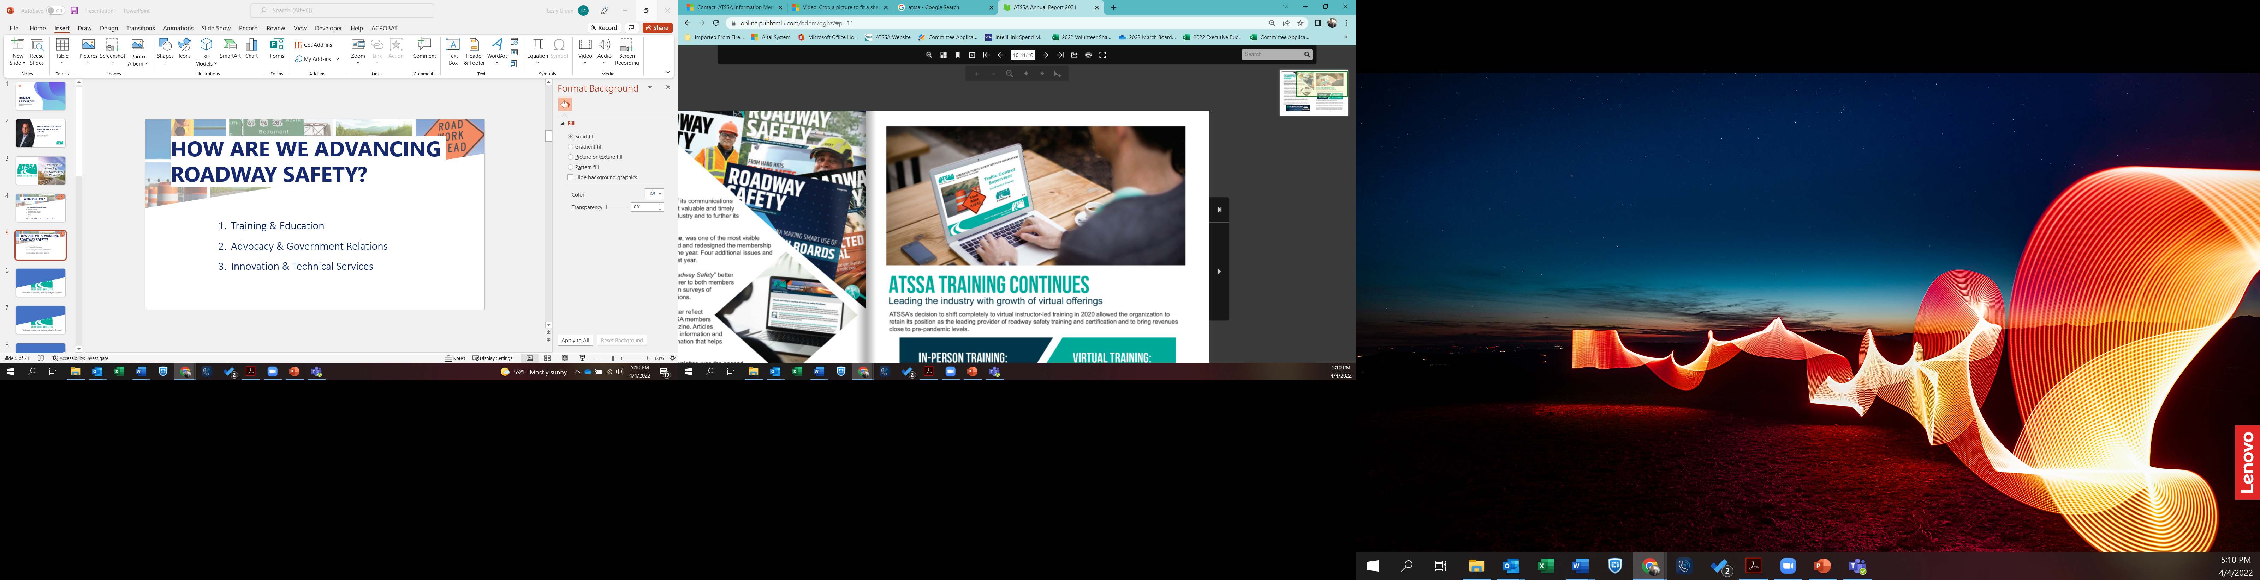
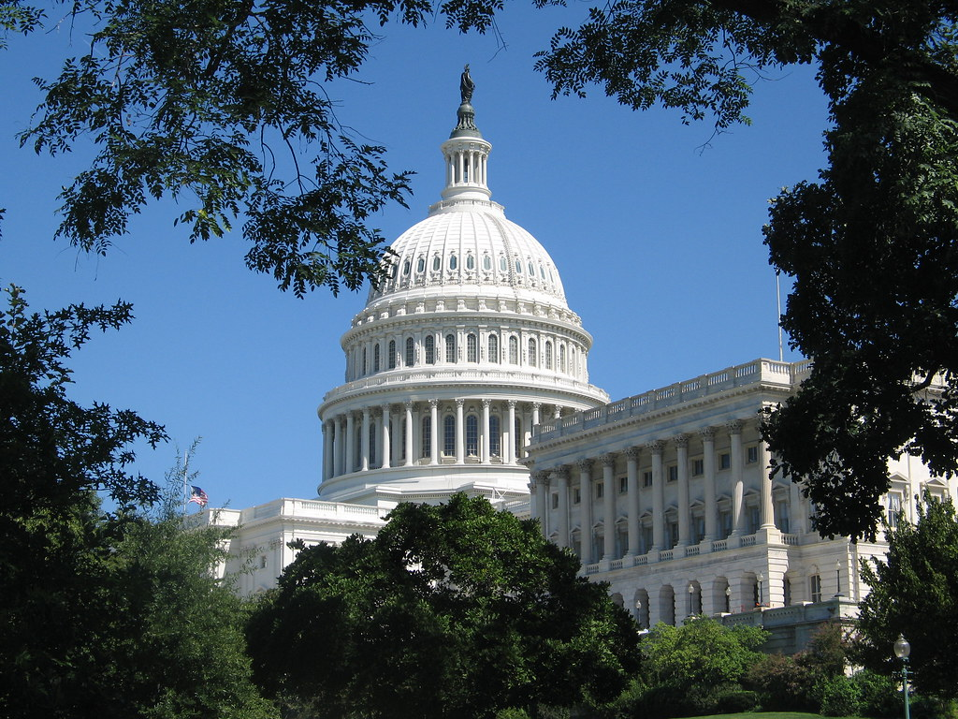

How We Advance Roadway Safety…
Training & Education
Innovation & Technical Services
Advocacy & Government Relations
This Photo by Unknown Author is licensed under CC BY-ND

Slide 3


TRAINING & EDUCATION
Roadway Worker Safety Training & Certification
Workforce Development
Meetings & Traffic Expo
Safety Forums

Slide 4

What’s New In Training?
Virtual, online and in-person opportunities
Flagger Certification
Traffic Control Technicians & Supervisors
Temporary Traffic Control Orientation
Pavement Marking Inspections
State & Municipality Specific Courses

Slide 5
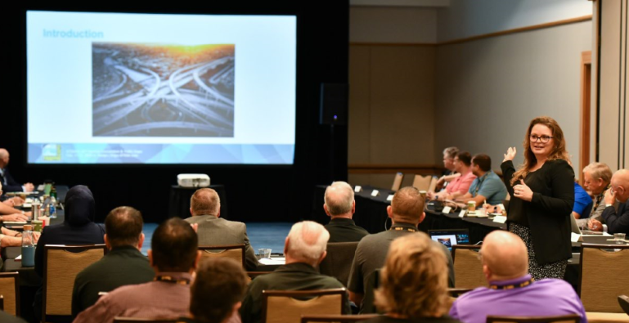

Roadway Worker Protection
New Council Formed with Focus on Education & Resources
ATSS Foundation
  Roadway Worker Memorial
  Scholarships
  Teen driver education on work zones

Slide 6
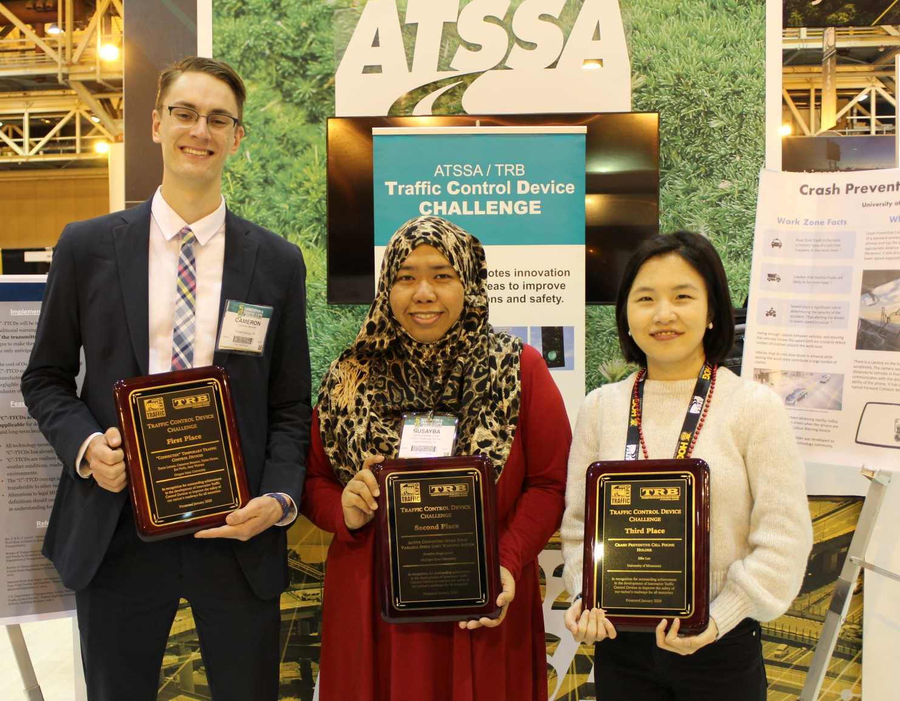
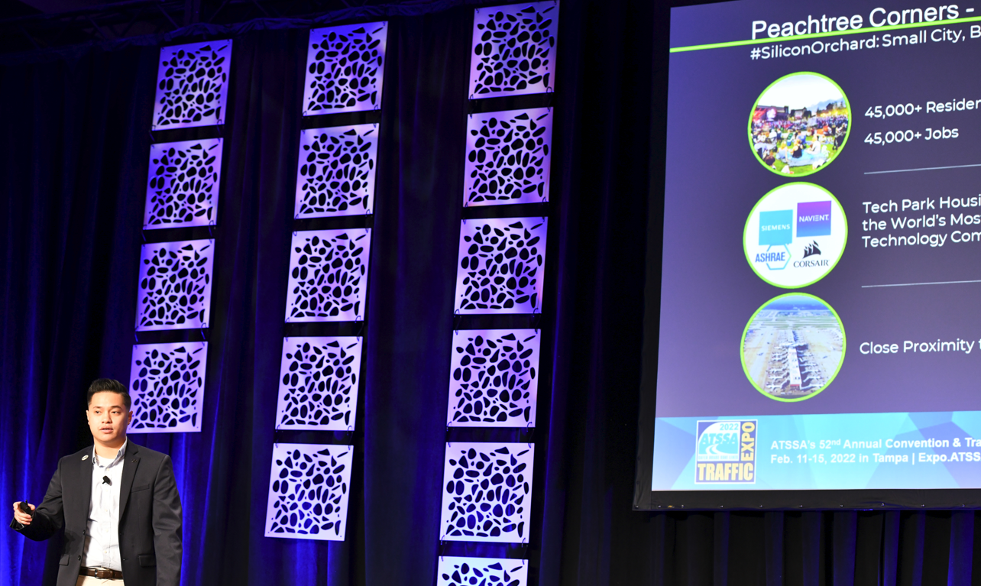
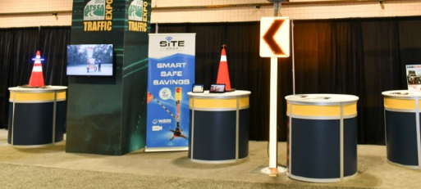
INNOVATION & TECHNICAL SERVICES
Roadway Safety Innovations
  Traffic Control Device Student Challenge
  Circle of Innovation
  New Product Rollouts
  Innovation Awards

Slide 7

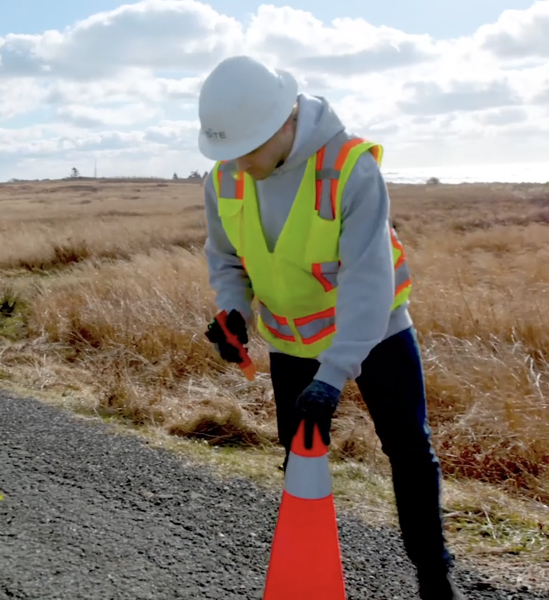
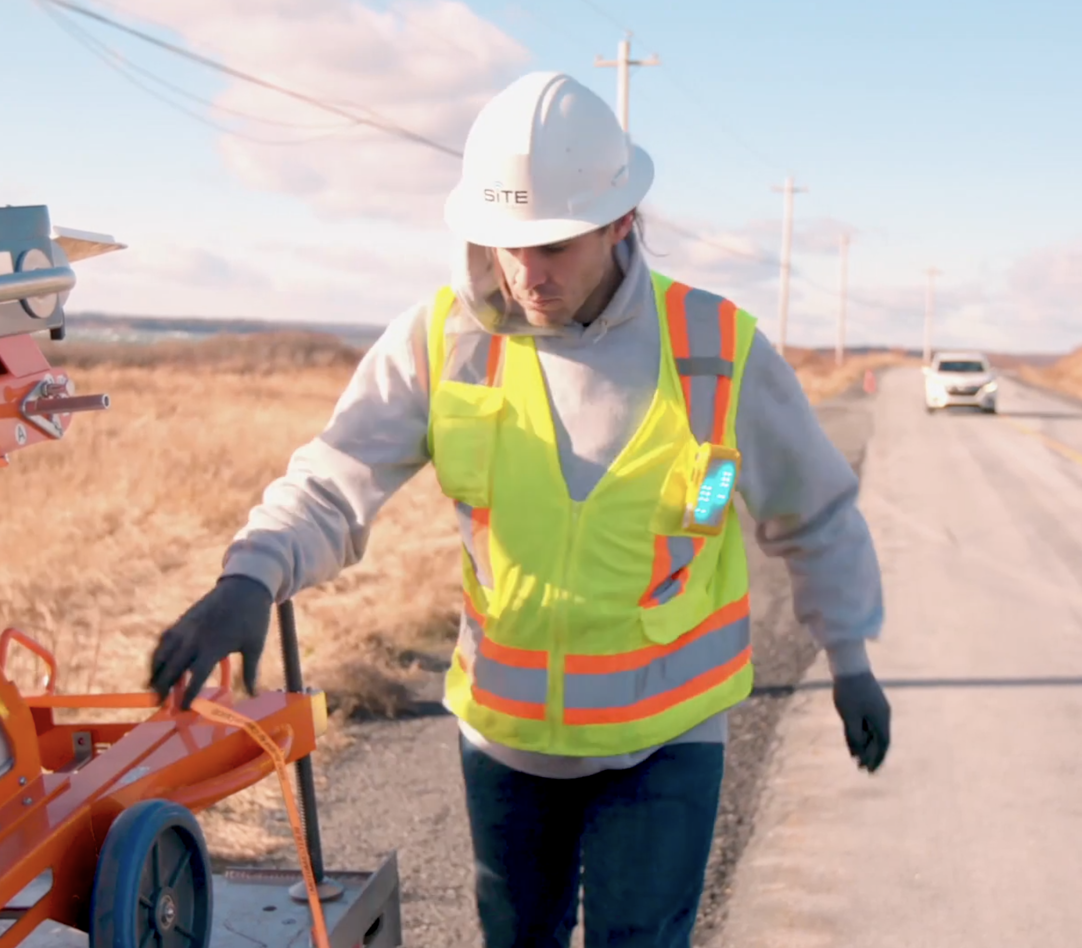
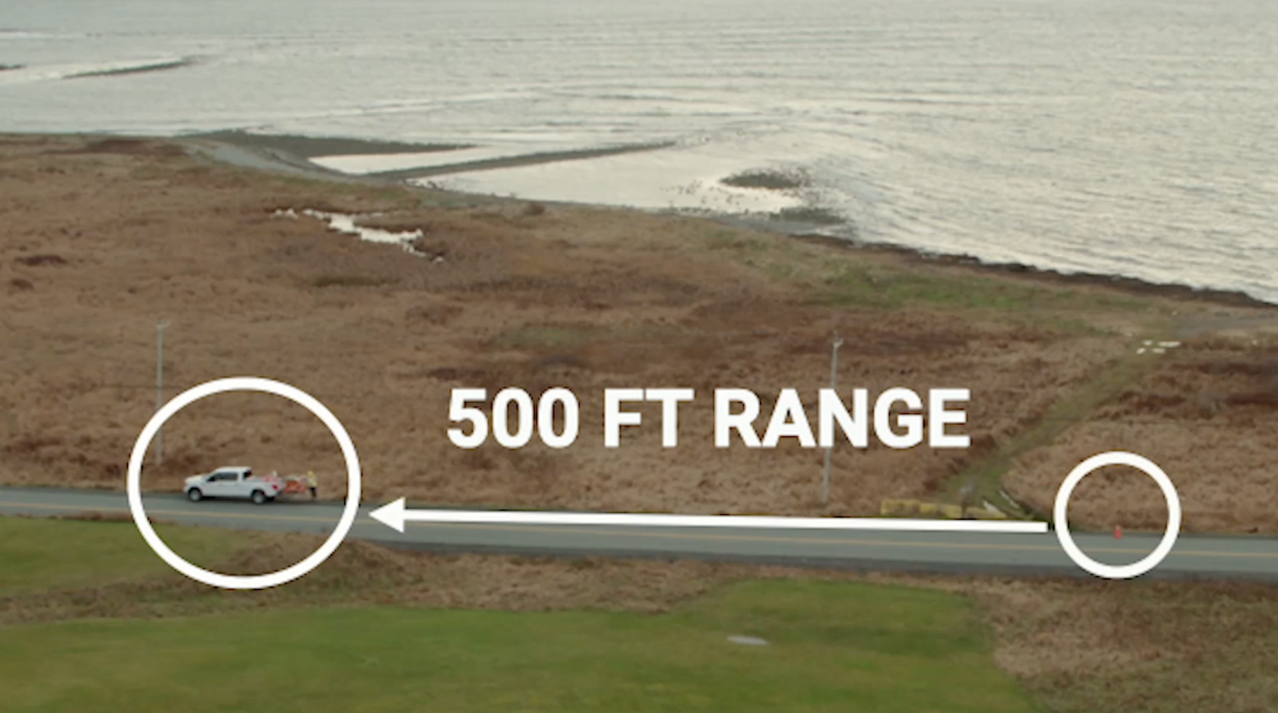
INNOVATION AWARD WINNERS
Work Zone Safety

Slide 8
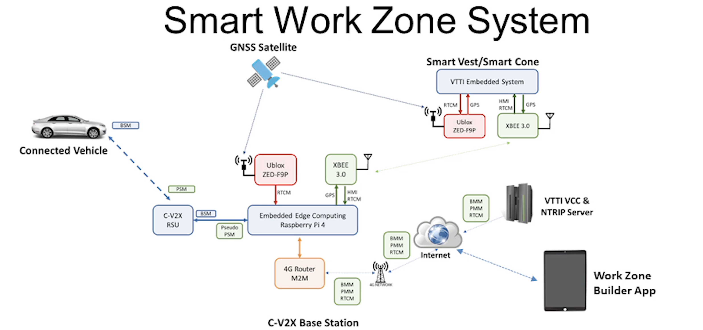
INNOVATION AWARD WINNERS

Slide 9
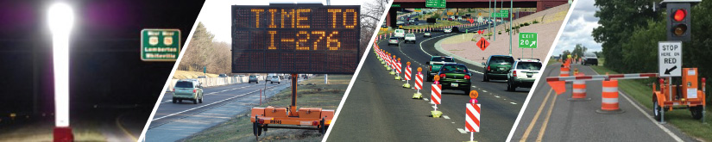
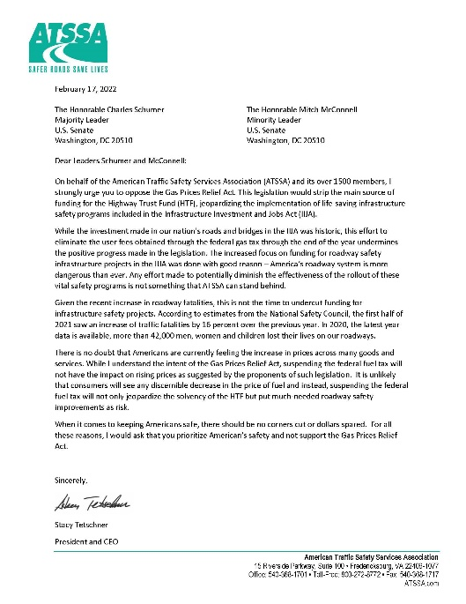
INNOVATION & TECHNICAL SERVICES
2. Addressing Industry Issues
  Material shortages
  Major material and fuel cost increases
Ensuring roadway safety has a seat at the table
  MUTCD revisions
  LED Flicker Rate

Slide 10
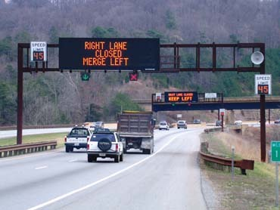
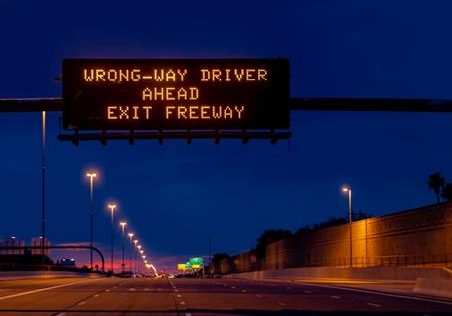
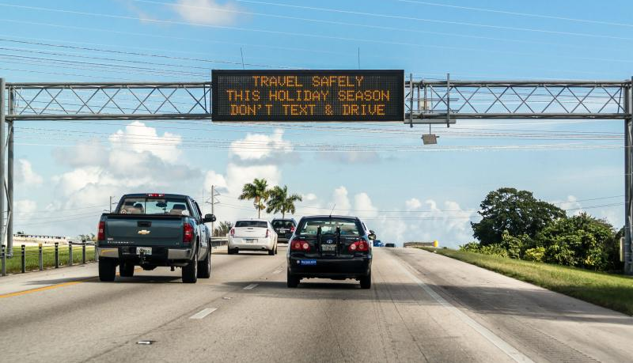
LED Flicker Rate
Safety Issue: A light source (the LED) has a constant flicker even though the human eye sees it as a constant light. The automated vehicles can't fully detect the light source as they are not on the same cycle/wave length and cannot detect one another. The result:
the vehicle only sees a light source that blinks on and off
the vehicle only sees a variation of brightness and colors from a light source
the vehicle sees a banding effect that does not allow it to recognize signs/messages

Slide 11
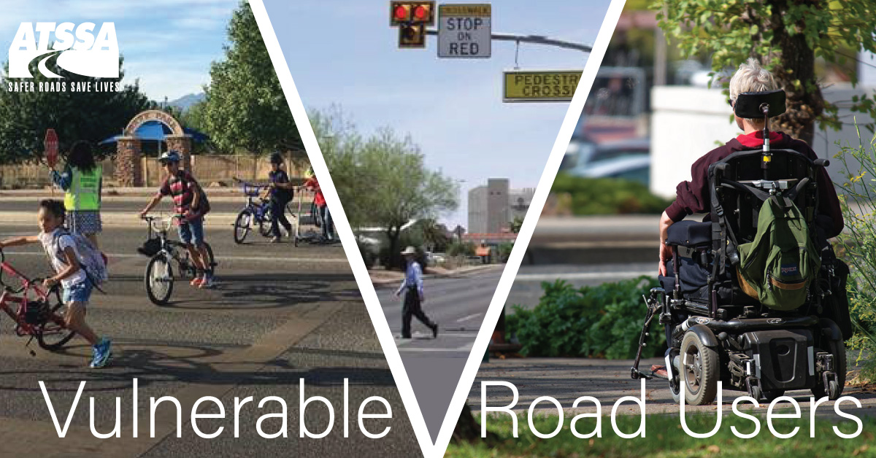

ADVOCACY AND GOVERNMENT RELATIONS
Advocating for roadway safety and funding at all levels
Buy America – clarity on definitions for construction materials, temporary devices, etc.
Gas Tax and Highway Funding
Arranging Congressional Site Visits
State Level Issues

Slide 12

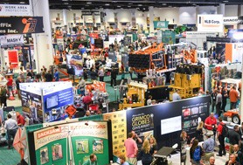

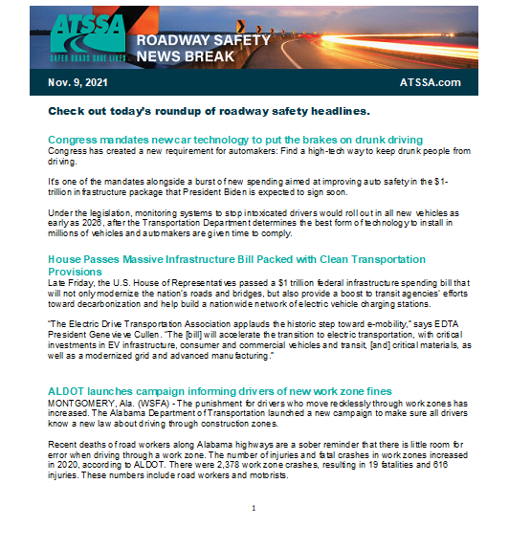
Connect with us…
Roadway Safety Magazine & Roadway Safety Newsbreak
www.atssa.com & LinkedIn
Attend the ATSSA Traffic Expo (Feb. 17-21,2023 – Phoenix, AZ)
East Coast Roadway Safety Summit (May 16-18, 2023 – Richmond, VA)

